Slide 1
Integrating NGSS Cross-Cutting Concepts Into Science Notebooks & Journals
Dr. Vickie Harri
Oaks Middle School
Ontario-Montclair School District

Slide 2
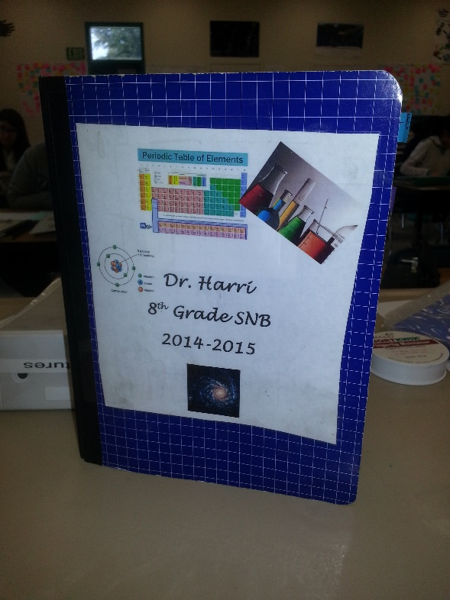
Dillema
How do I incorporate the cross-cutting concepts into the science notebooks and journals that are an integral part of my instruction?

Slide 3
Cross-Cutting Concept Posters
Icons developed by Pete Ahern.
http://crosscutsymbols.weebly.com/

Slide 4
Develop student friendly definitions of the cross-cutting concepts.

Slide 5
Copy onto worksheet for reference page in student science notebook. We covered one concept per week.

Slide 6
Cross-Cutting Concept Activities
Energy & Matter – video clip of decomposing watermelon
Systems – body systems
Structure & Function – structure and function of a bicycle worksheet
Patterns – ruler drop activity
Scale – Eames Power of 10 video
Stability & Change – paper airplanes
Cause & Effect – rattleback activity

Slide 7
Fill out Cross-Cutting Concepts Summary Table
Share with a partner.

Slide 8
Each pair developed a definition of the concept and wrote it on a sticky note.
I color code each class.

Slide 9
Definitions are shared with the class and put on a poster.

Slide 12
Integration into Notebooks

Slide 13
Journal prompts
How does the icon apply to the cross-cutting concept of Scale?

Slide 14
How does the cross-cutting concept of Stability and Change apply to Physical vs. Chemical (properties and changes)?

Slide 15
Cause & Effect
When we do science we try to find out the reasons why things happen. What causes have you identified? What effects do they produce? What is your evidence?

